Slide 1
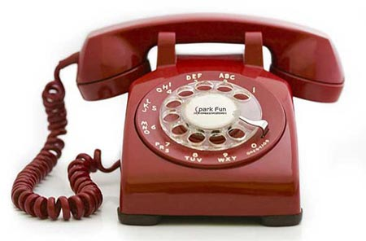
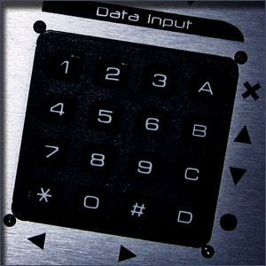
Touch Tone Recognition
EE301 Final Project
Group 1
Norman Chung
Rocky Mark Juan
Hieu Nguyen
Alexander Nobles
Bryce Toth
Notes:
-Intro (ALL)
-What is DTMF? (Alex)
-Applications of DTMF (Bryce)
-How is our project related to EE 301 (Norman)
-Brief overview of our MATLAB codes (Hieu)
-Results and Problems (Rocky)
-Individual Contribution (ALL, we can have a slide each when talking about our own contributions...or we could just have a general slide while where we each talk about what we worked on)
-Demonstration of our MATLAB (GUI, maybe using the DTMF to call through a land line)
- Intro
- System Design
- description of system
- issues
- basic results
- remaning problems
- individual sections
- tasks involved
- solution/results
- open problems
- conclusion

Slide 2
Brief overview of Matlab codes
GUI walkthrough (snippets of Matlab code)
DTMF generation
Parse DTMF sound file
Bandpass filters
Scoring function
Return corresponding text string
SNR

Slide 3
Individual slide
What you worked on
Creating the GUI
Graphical user interface to easily integrate our project functions together (dtmf generation, noise filtering, etc.)
Make project demonstratable/presentable
tasks involved
solution/results
open problems
Dtmfscore
Scoring function used to determine if a specific sinusoid is present in the DTMF signal, given impulse responses for bandpass filters

Slide 4
Demonstration
DTMF from keypad
Time-domain Graphs
Recognize
Add noise
Filter
Recognize
Freq-domain Graphs
Mention DTMF from string entry
Real-time DTMF recognition from recording

